Slide 1
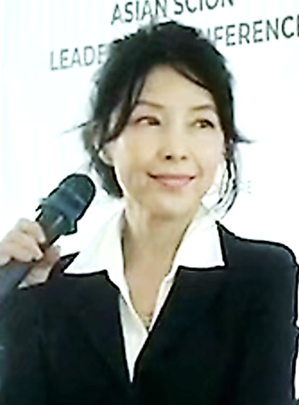






FORTUNE 500 Strategic CFO
Finance, Strategy, Transformation, Operational Excellence
Fortune 500 leadership (Microsoft, Diageo, Energizer, BAT, Boston Scientific, Avery Dennison):
Managed 6 regions spanning over 40 markets (6 regions: APAC, MEA, GCR, SEA, Australasia, Emerging Markets).
Led full-spectrum Finance, Strategy, Transformation, Business Development, and Governance.
Drove profitable growth, turnarounds, market expansion, operational & process excellence, capability development, collaborating with diverse teams and stakeholders globally.
P&L Responsibility , revenue up to USD $6b
Entrepreneurial Agility:
Lead full-cycle consulting and provide in-house leadership, partnering with global teams to scale business, guide strategies and execution, and build operational structure and capability.
Strategic execution & Collaborative Impact
Drive strategies and executions to deliver performance targets and long-term sustainable growth.
Collaborate with and influence C-suite and cross-cultural stakeholders to align and drive priorities.
APAC Expert and Strong Network:
Multilingual (Mandarin, Cantonese, English, Bahasa Indonesia) with on-the-ground experience in multiple APAC markets.
Leverage global network and cultural fluency to foster collaboration and build strategic alliances.
Isabella Lan
Isabella Lan
Lan.isabella@gmail.com
Linkedin profile
https://www.linkedin.com/in/isabellalan/

Slide 2
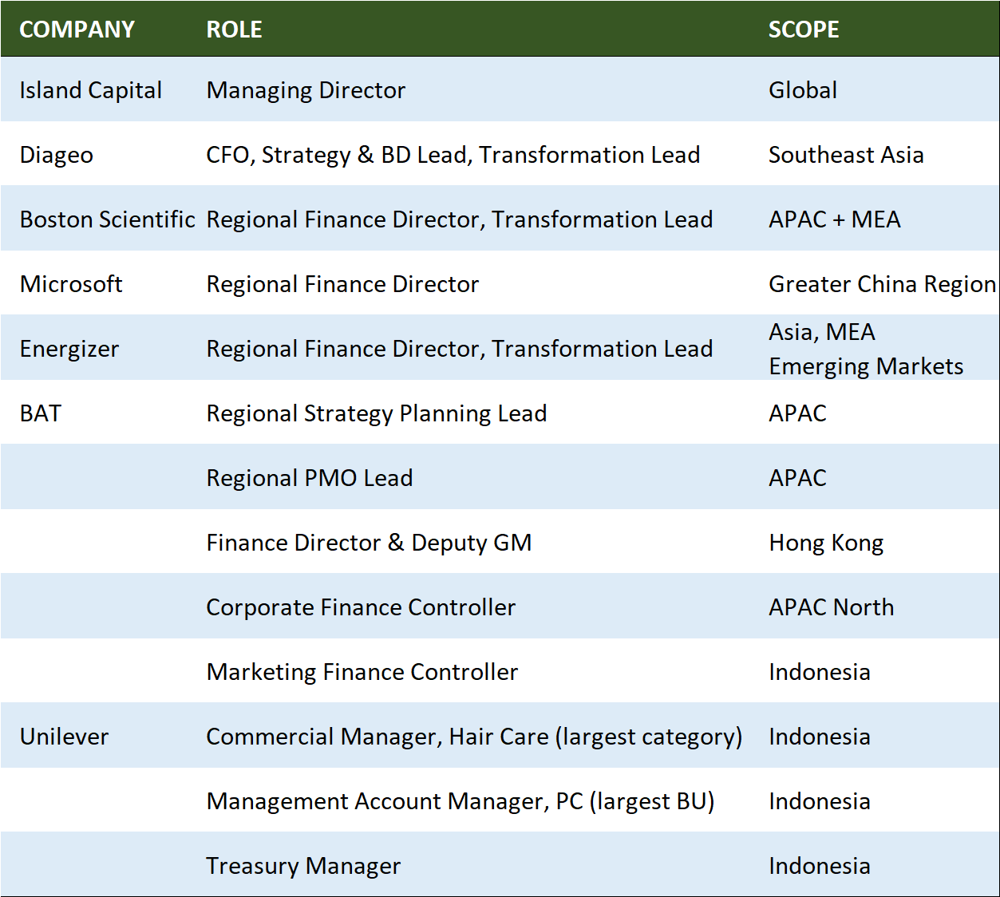
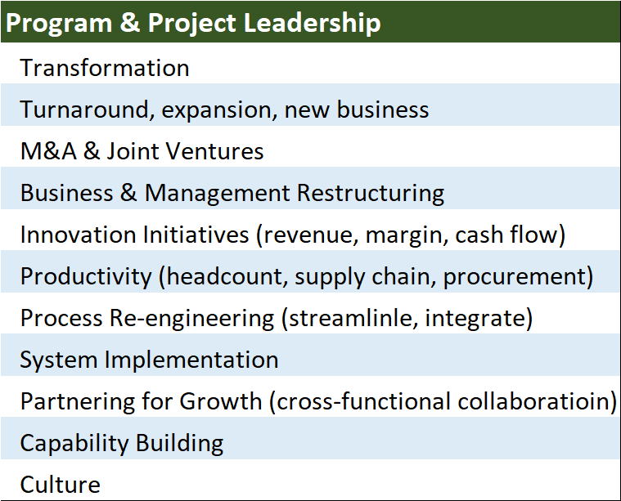
CAREER OVERVIEW Leadership in Finance, Strategy, Transformation, Governance, Consulting

